Slide 1
Data Science Engineering Methods and Tools Lecture 1
Northeastern University
College of Engineering
Multidisciplinary Graduate Engineering Department
INFO 6105 – Fall 2024
Instructor: Abdolreza Mosaddegh

Slide 2
Topics Covered in this Course
Introduction to Data Science
Data Preprocessing
Decision Trees
Clustering Methods
Regression
Association Rules
Bayes Classifier
Markov Chain
Ensembles and Super learners
Dimensionality Reduction
Support Vector Machine
Neural Networks
Transfer Learning
Introduction to Deep Learning
Introduction to Generative AI
Introduction to Big-data Analytics

Slide 3
Course Prerequisites
Graduate Level CSYE 6200 Minimum Grade of B- or Undergraduate Level INFO 5100 Minimum Grade of B- or Graduate Level INFO 5100 Minimum Grade of B-
Statistics and Linear Algebra
Basic Programing proficiency
Python is used as primary programing languages in this class but other programing languages such as R, Java, and C# are also acceptable.

Slide 4
Course Overview
Course Title: Data Science Engineering Methods and Tools
Course Number: INFO 6105
Term and Year: Fall 2024
Credit Hour: 4
Course Format: On-Ground
Instructor: Abdolreza Mosaddegh
Email : a.mosaddegh@northeastern.edu
TA: Shubham Krishnakumar Nair
TA Email: nair.shu@northeastern.edu
Assignments and Resources: Canvas

Slide 5
Grading
Assignments: 30%
Quizzes: 20%
Midterm Exam: 10%
Final Exam: 20%
Final Project: 20%
Lecture: +5% Additional

Slide 6

AI is the New Electricity
Electricity changed how the world operated. It upended transportation, manufacturing, agriculture, health care. AI is poised to have a similar impact
Andrew NG
JavaPoint

Slide 7
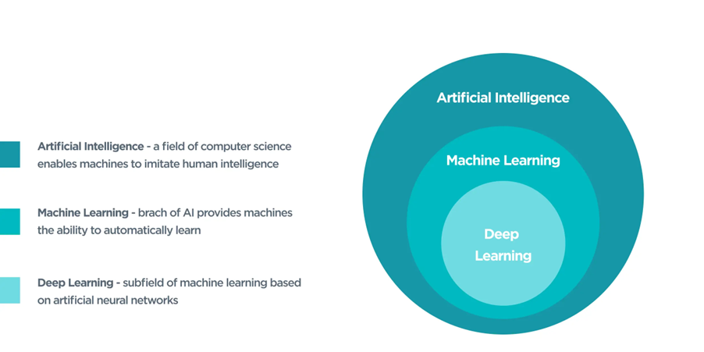
ByteAnt
“Machine Learning: Field of study that gives computers the ability to learn without being explicitly programmed.”
Arthur Samuel
AI does not always imply a learning-based system
e.g., Rule based system

Slide 8
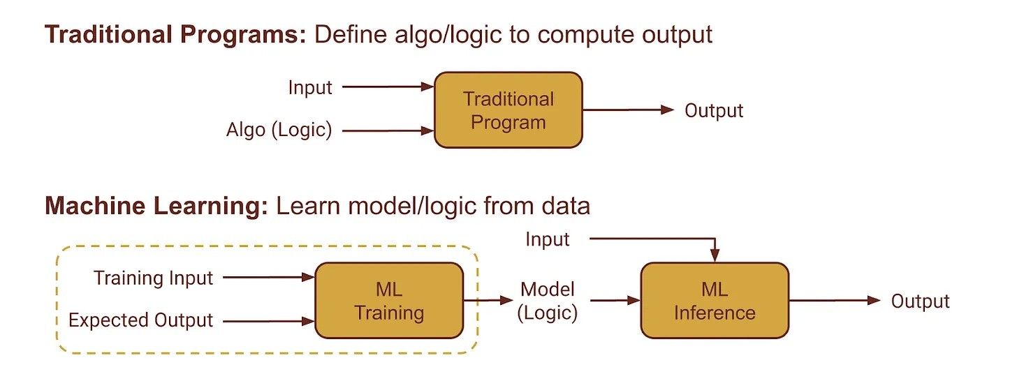
Learning vs Programing
Programming: Explicit instructions for the computer to follow.
Learning: Models can learn from data.

Slide 9
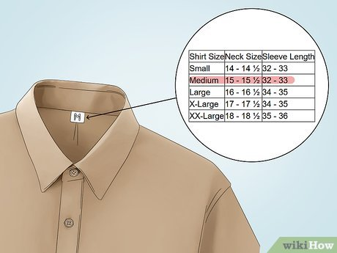
Learning vs Programming - Example
Grouping shirts based on size
Programming:
If Neck size< 16 then Small
If Neck size >= 16 then Large
…
Machine Learning:
Group shirts based on similarity with Neck Sizes in data records.

Slide 10
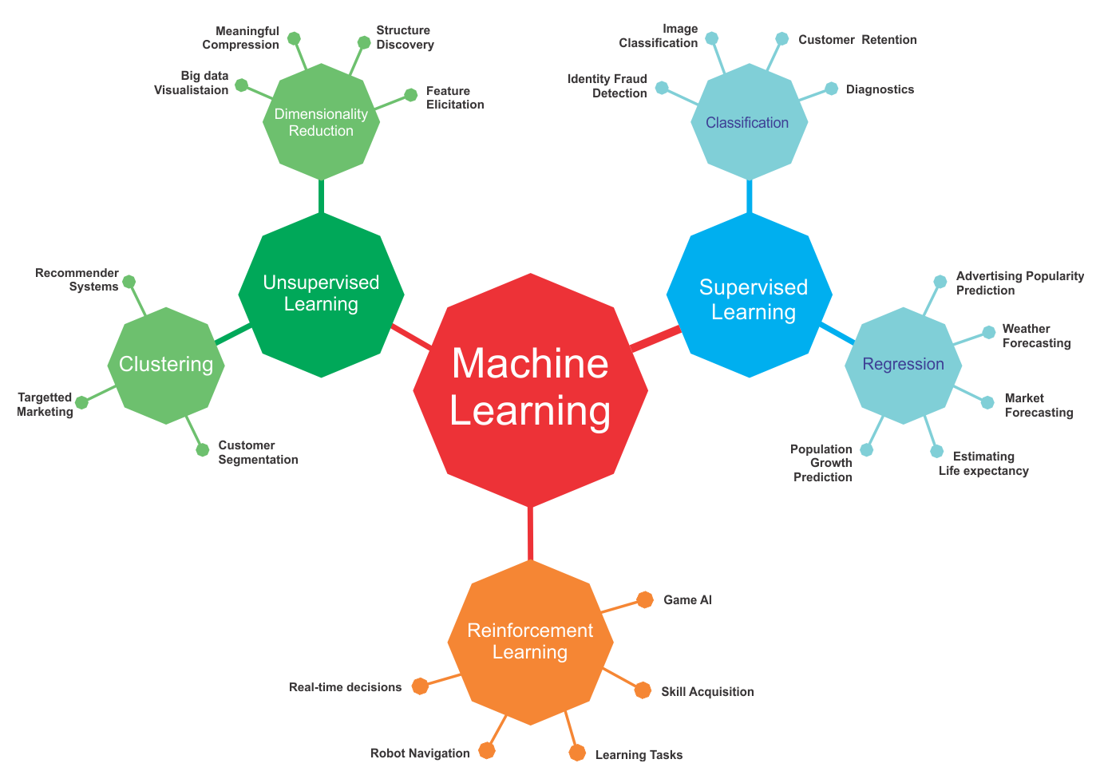
Semi-Supervised
Learning using unlabeled data
Self-Supervised
Learning using labeled data
packt
Learning through Interactions with an environment

Slide 11








A Typical Supervised Learning
Labeled Training Data
“dog”
“dog”
“dog”
“dog”
“dog”
“cat”
“Features”
“dog”
“cat”
“cat”
“cat”
“cat”
The feature extraction phase may be part of the machine learning algorithm itself
“cat”
Training
Cat=0
Unknown Data /
Test Data
Classification Model
Predicted Label
Dog=1
“Features”
Production /
Testing

Slide 12
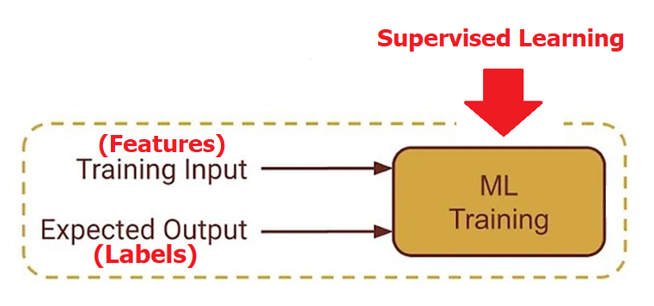
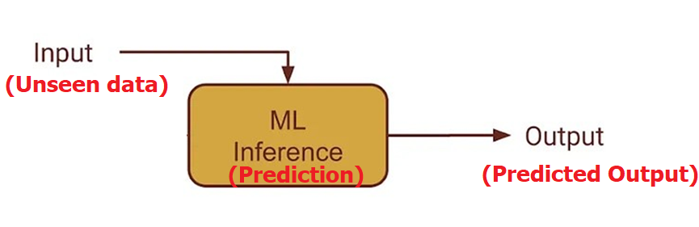
Supervised Learning
Predicting a class/value for new data based on data in training set
Training data includes both inputs (features) and desired outputs (Labels).
Goal : Predict new (unseen) data with the least error.

Slide 13
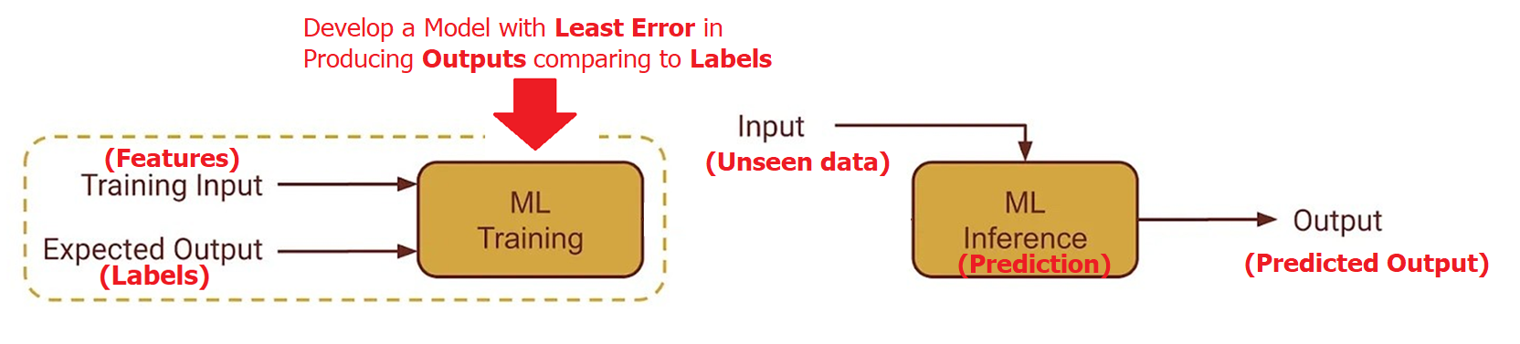
Problem Statement
Develop a model classify predict new data with the least error
To quantify the error, we need to define a measure (Loss Function)
A loss function compares the label against the output that our model currently predicts

Slide 14
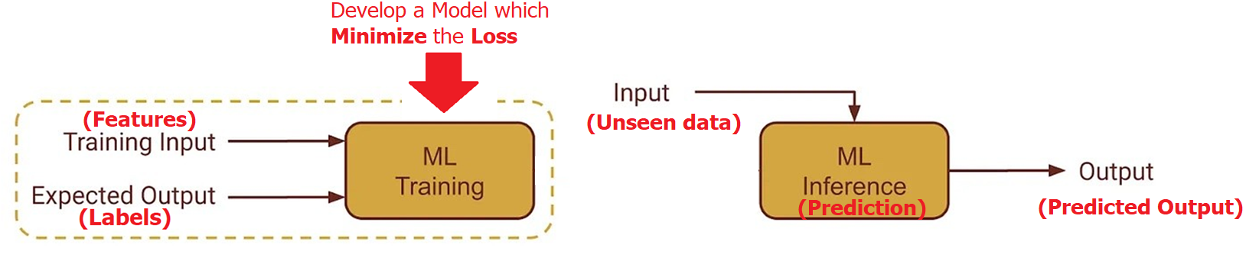
Training Steps
1-selecting the type of machine learning algorithm appropriate for a particular problem.
2- define a loss function to evaluate model. A loss function evaluates a model on our training data and tells us how bad it is. The higher the loss, the worse it is. A loss of zero means it makes perfect predictions.
3- Train a model on a dataset which minimize the average loss
4- Test the trained model with a new data (unseen data during training)

Slide 15
Supervised Learning - Example
Problem: Group shirts based on their sizes
1- Algorithm:
Select a Neck Size in data as the threshold of grouping which minimize loss function
2- Loss Function:
Goal: Predicted size-group of a shirt by the model is the same as real size-group of the shirt
→ If Predicted Size = Real Size then Loss = 0
Else Loss = 1

Slide 16
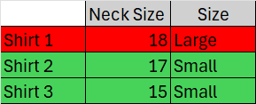
Employing Loss Function on Training Data
3-Training Model on Data:
Threshold = 18 → Neck Size > 18 Large else Small
Average Loss = (1 + 0 + 0) / 3 = 0.33
2) Threshold = 17 → Neck Size > 17 Large else Small
Average Loss = (0 + 0 + 0) / 3 = 0
3) Threshold = 15 → Neck Size > 15 Large else Small
Average Loss = (0 + 1 + 0) / 3 = 0.33
Best by the Least Loss = 2
Feature Label

Slide 17
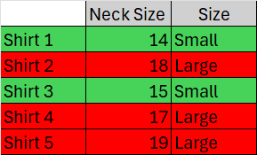
Test Model on Unseen Data
Feature Label
4- Test Model for Prediction on New Data:
Neck Size > 17 Large else Small
Shirt 1: Correct Prediction
Shirt 2: Correct Prediction
Shirt 3: Correct Prediction
Shirt 4: Wrong Prediction
Shirt 5: Correct Prediction
Accuracy of Model = Number of True Predictions / Total Cases
= 4 / 5 = 80%

Slide 18
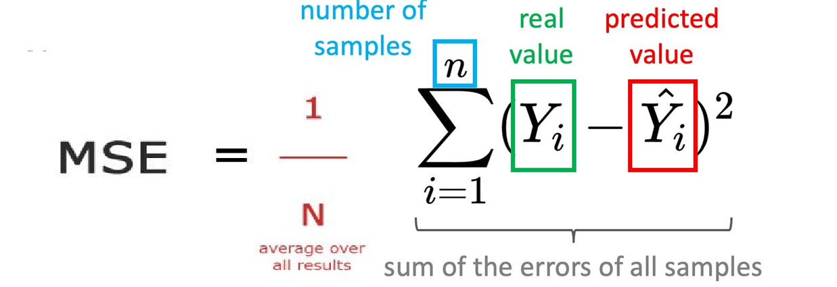
Various Loss Functions
Zero-one
Categorical Output
Mean Squared Error
Scalar Output

Slide 19
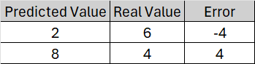
Loss vs Error
Error measures the deviation of an observable value from a prediction
Error = Predicted Value - Real Value
Sum of Errors = (2-6) + (8-4) = 0
Loss is a measure which quantifies errors in a way that can be used for optimization. Error is not necessarily equal to Loss.
Loss = Average Sum of Squared Errors = ((2-6)^2 + (8-4) ^2)/2 = (16+16)/2 = 16
What is the ideal Error / Loss ?

Slide 20
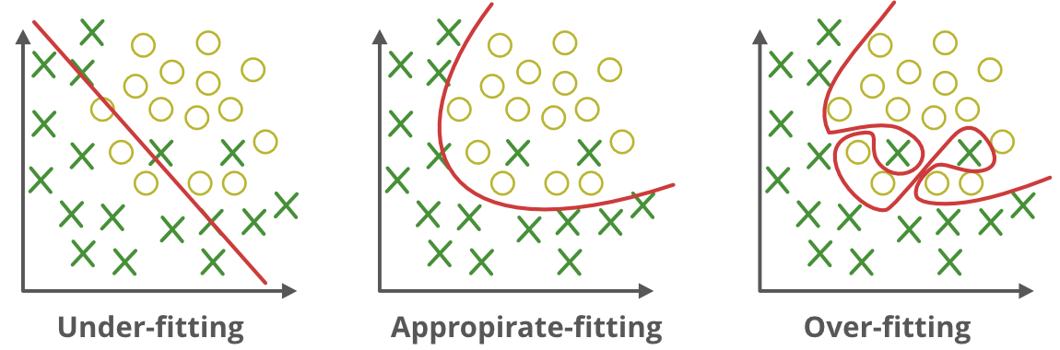
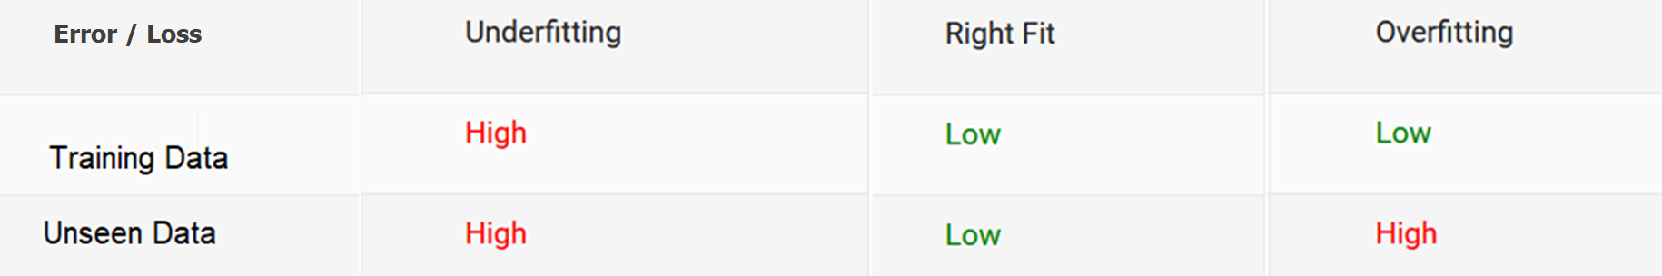
Under-fitting vs Over-fitting
Our goal is not just to create a model that perform well on data used for training the model but also perform well for unseen data

Slide 21
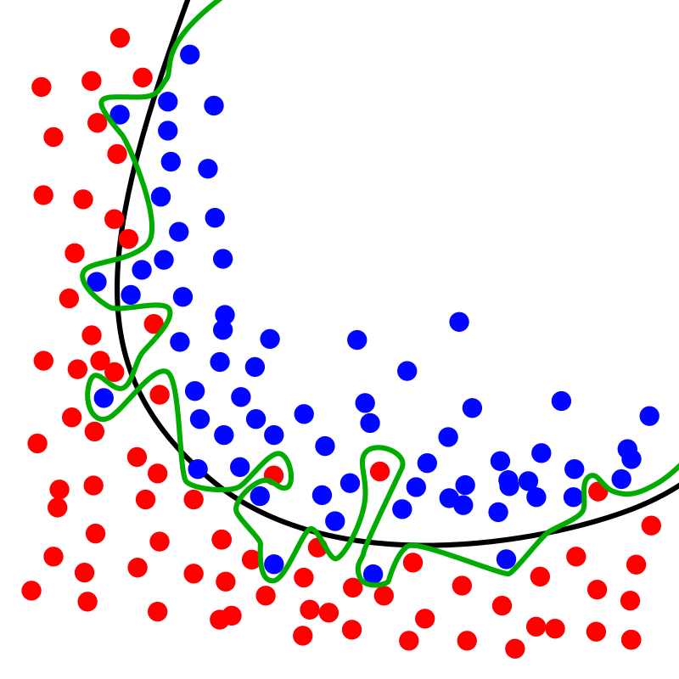
Avoid Overfitting
Using algorithms which are more robust against overfitting
Reducing complexity of model
Feature Reduction
Train with more data
Using validation data
…

Slide 22
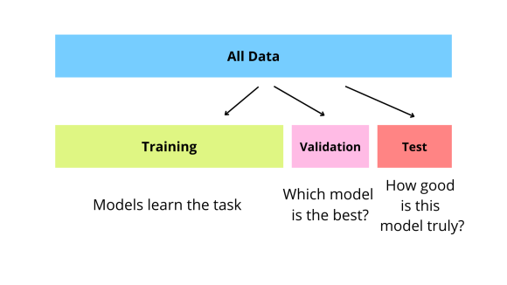
Train / Test/ Validation
To resolve the overfitting issue, we usually split into three subsets:
Train
Test
Validation
Best practice:
Train : 70%-80%
Validation : 5%-10%
Test: 10%-25%

Slide 23
Splitting Train and Test data
Train and test data should be separate completely
We should not touch test set during training
Before training/learning, randomly split train and test data
The test set must simulate a real-world scenario using unseen data
Avoid over-sampling , under-sampling, etc. on test data

Slide 24
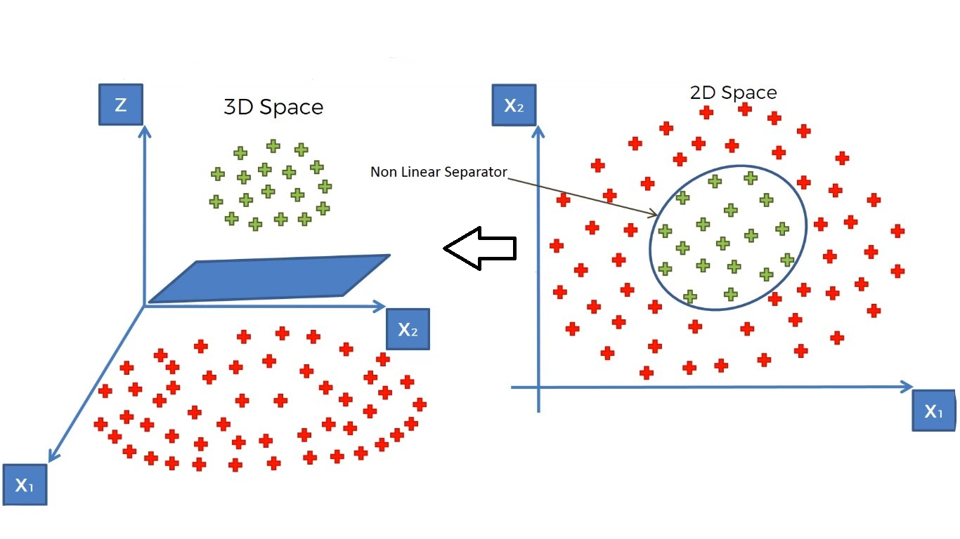
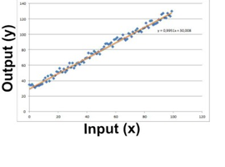
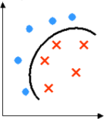
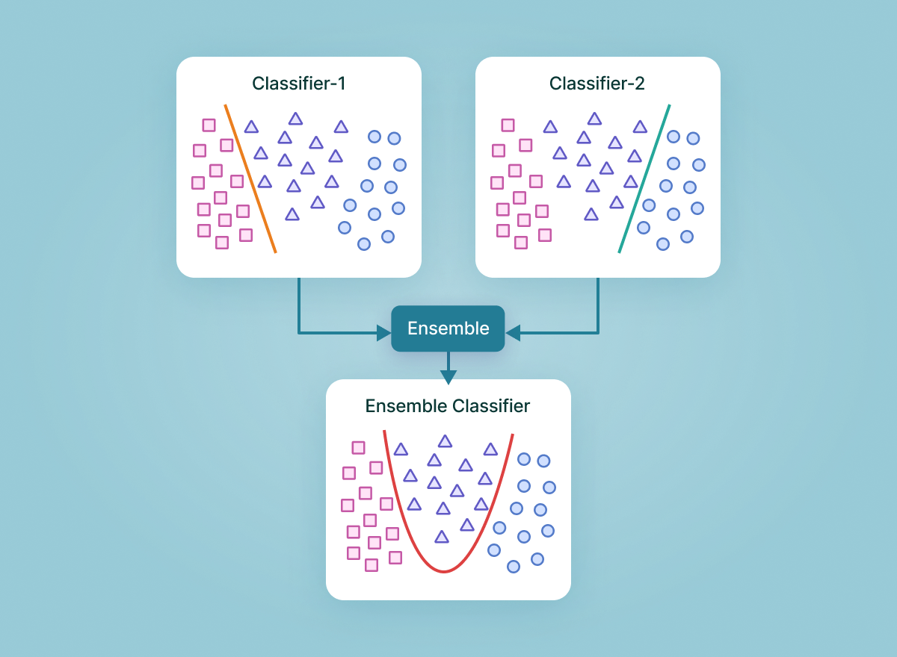
Some Supervised Approaches
Regression
Learn a line/curve (the model) using training data consisting of
Input-output pairs.
Use it to predict the outputs for new inputs
Linear Regression
Logistic Regression,
Support Vector Machines
SVM
Support Vector Machine (SVM) models have the ability to perform a non-linear regression / classification by mapping their inputs into high-dimensional feature spaces
Classification
Learn to separate different classes (the model) using training data consisting of input-output pairs
Use it to identify the labels for new inputs
Ensembles
Ensemble methods are machine learning techniques that combines several models in order to produce optimal models
Two-Class Nonlinear Classification
Support Vector Machines, Decision Trees,
Neural Networks

Slide 25
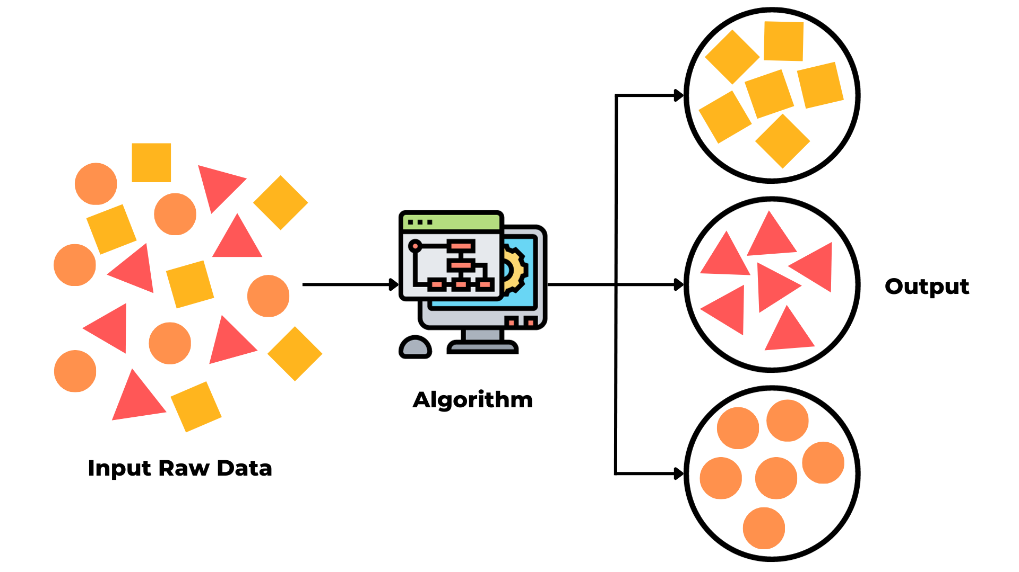
Unsupervised Learning
Learning about relations in data
Most available data is unlabeled
Labeled data can be expensive and time-consuming to obtain
Goal:
Reveal structure of data
Detect similarities / distances
Detect anomalies
Extracting patterns
Summarizing data
Discovering associations.

Slide 26
A Typical Unsupervised Learning
Unlabeled Data
“Features”
Clustering
Model
Cluster 1
Cluster 2

Slide 27
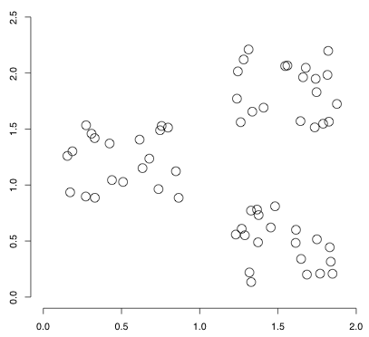
Loss Function in Supervised vs Unsupervised
Supervised learning
A loss function is used to choose a particular model with the lowest loss value
After training and testing the model, we don’t care about the loss function
Unsupervised learning
A loss function characterizes what the data looks like
The loss function is our data model, and is itself our primary goal

Slide 28
Unsupervised Learning - Example
Problem: Group shirts into two size groups
1- algorithm:
Find two groups of shirts in a way that minimize the loss function
2- Loss Function:
Goal: less difference in sizes of each group of shirts
→ Loss Function = ABS (Neck size – Average Neck size in the Group)

Slide 29
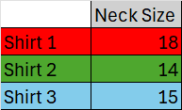
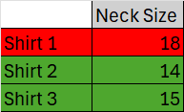
Feature (With no Label)
3- Training
Grouping 1: Shirt 1,2 in group 1 and Shirt 3 in group2:
Average group1 = 16, Average group2 = 15
Average Loss = (abs(18-16) + abs(14-16) + abs(15-15))/3 = 4/3
Grouping 2: Shirt 1,3 in group 1 and Shirt 2 in group2 :
Average group1 = 16.5, Average group2 = 14
Average Loss = (abs(18-16.5) + abs(15-16.5) + abs(14-14))/3= 3/3=1
Grouping 3: Shirt 2,3 in group 1 and Shirt 1 in group2 :
Average group1 = 14.5, Average group2 = 18
Average Loss = (abs(14-14.5) + abs(15-14.5) + abs(18-18))/3= 1/3=0.33 ← The least loss

Slide 30
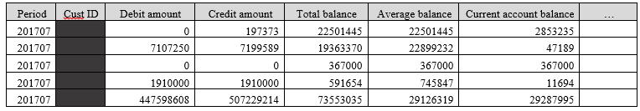
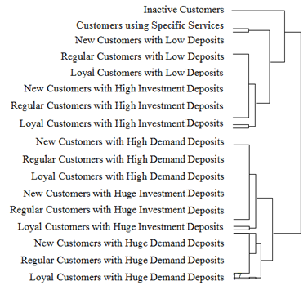
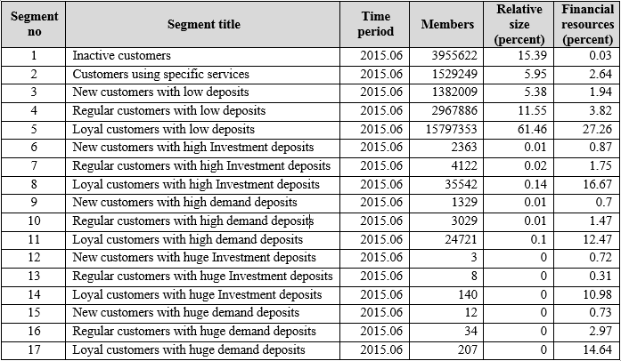
Semi Supervised
Labeled data is limited
Finding representations for supervised or other unsupervised models
Unlabeled data
Hierarchical Clustering
Using labeled data in other ML models

Slide 31
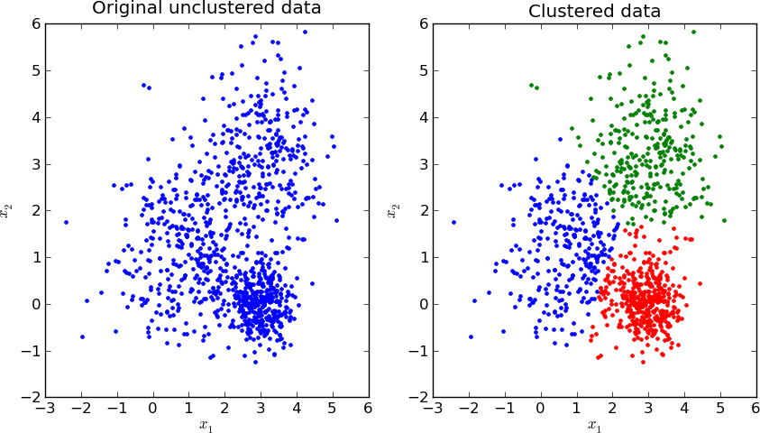
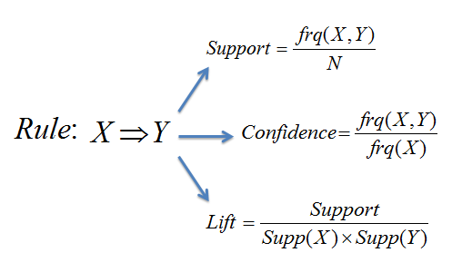
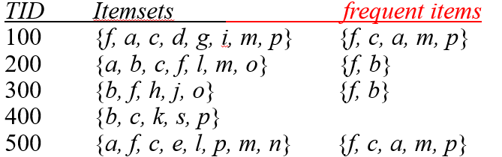
Some Unsupervised Approaches
Clustering
Learn the grouping structure for a given set of unlabeled inputs
k-Means, Hierarchical Clustering, ...
Association Rules
Association rule mining is a rule-based machine learning method for discovering interesting relations between variables in transactional databases.
Apriori, FP-growth, …

Slide 32
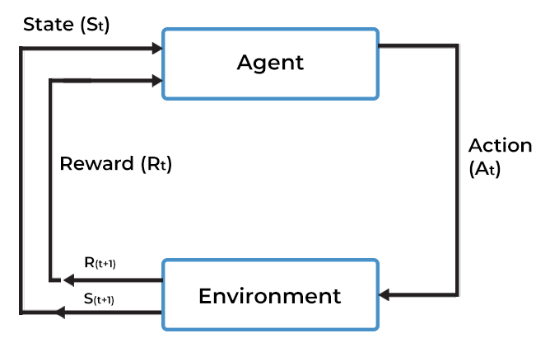
Reinforcement Learning
Learning optimal behaviors in an environment
In reinforcement learning, there is no answer/ label
Goal: obtain maximum rewards (and less penalties)

Slide 33
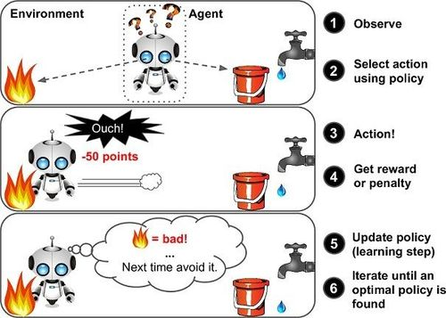
Typical Reinforcement Learning
marutitech

Slide 34
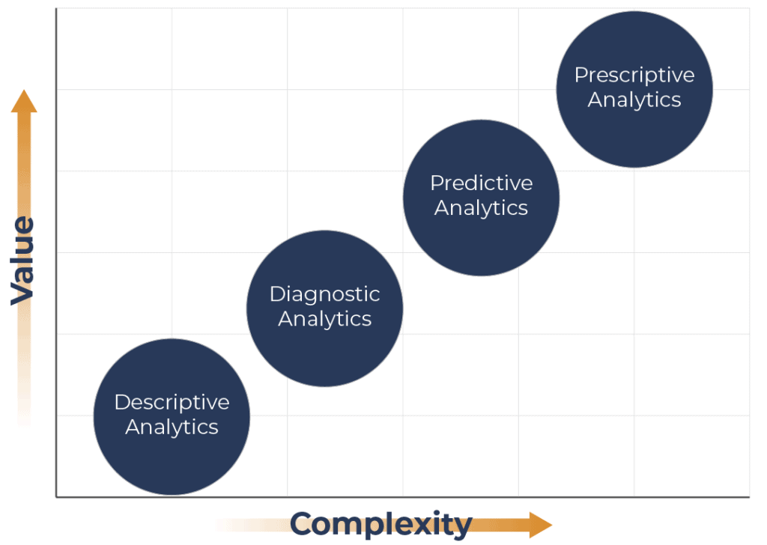
Types of Analytics
What should be done?
What is likely to happen?
Descriptive
Decision support systems, Autonomous Systems
Why did it happen?
Regression, Classification
What happened?
Correlations, Cluster Analysis, …
Gartner
Visualizations, Reports, …
Hindsight
Insight
Foresight

Slide 35
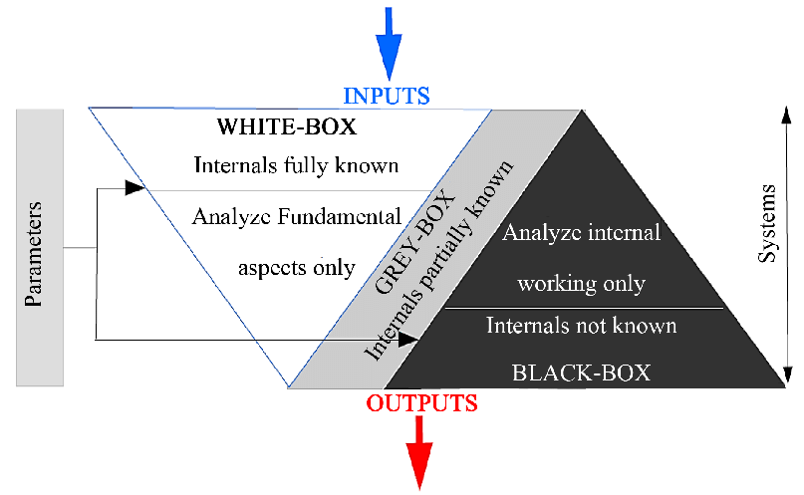
White-box vs. Black-box ML
Interpretable results for developing data-driven theories
Transparency makes more reliable results than opaque models
High predictive accuracy
Highly complex models

Slide 36
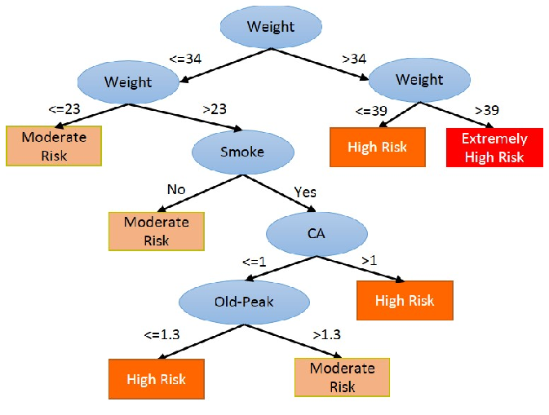
White-box Model- Decision Tree

Slide 37
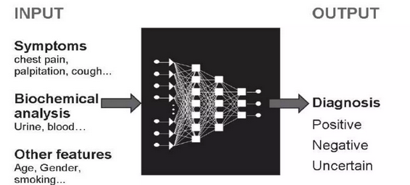
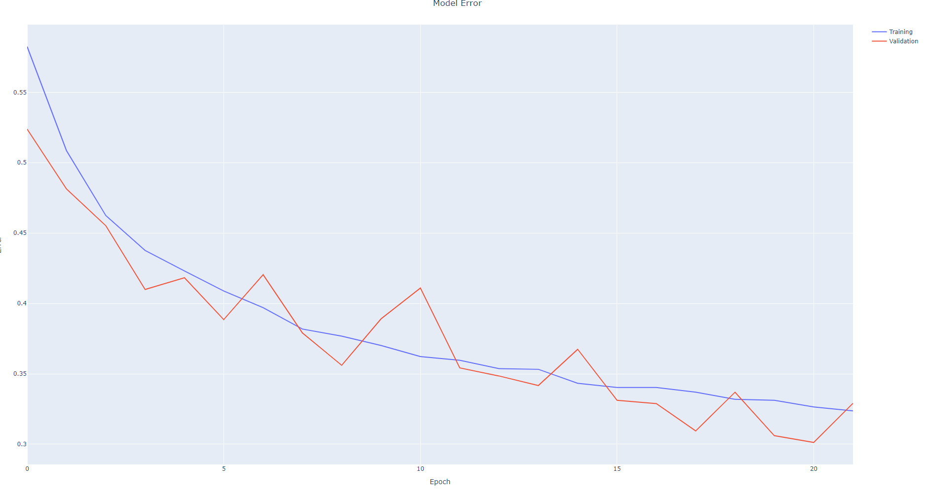
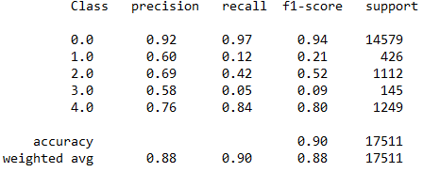
Black-box Model - Neural Network
Black-box models like Deep Neural Networks are capable of handling complex tasks
Interpretation of results is not straight forward
Less reliable since the mechanism of making outputs in not easily interpretable
ECG Classification

Slide 38



Significant Mistakes of AI Systems
Image Classification using a CNN
Class of Pic 1: Lion
Pic 1
Classification
Convolution
Class of Pic 2 : Lion
Pic 2
Max Pooling
Fully Connected Feedforward network
Same Class
Convolution
Same Features
Max Pooling
Flattened

Slide 39

Humans Capabilities vs AI
Image Understanding by a Human Being
Wildlife
Town Square
Contains
Contains
Wild Animal
Is a Subject of
Sculpture
Is a
Lion

Slide 40
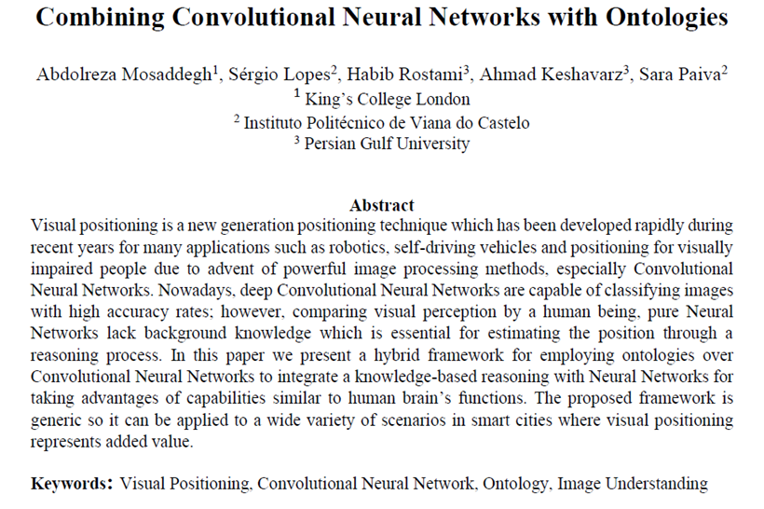
Advanced AI Solutions
Wildlife Park
Has
Urban Area
Has
Town Square
Contains
Contains
Wild Animal
Is a Subject of
Sculpture
Is a
Lion
Image Processing Systems:
Object classified as a Lion
Supportive Positional System (e.g. GPS):
Approximate Location: National Park
Ontology:
National Park is a Wildlife Park
Wildlife Park Contains Wild Animals
Lion is an Animal
Results By the Proposed VPS :
Object classified as a Lion
Exact Position: Section A of National Park
Image Processing Systems:
Object classified as a Lion
Supportive Positional System (e.g. GPS):
Approximate Location: Central Square
Ontology:
Central Square is a Town Square
Town Square Contains Sculptures
Animals are Subject of Sculpture
Lion is an Animal
Results By the Proposed VPS:
Object classified as a Sculptures of Lion
Exact Position: In the Middle of Central Square

Slide 41
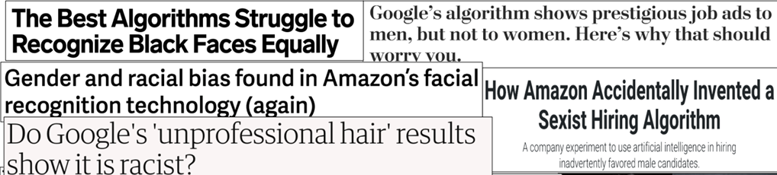
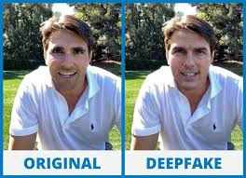
Ethical Issues in AI
Bias, Deep fake, Etc.

Slide 42
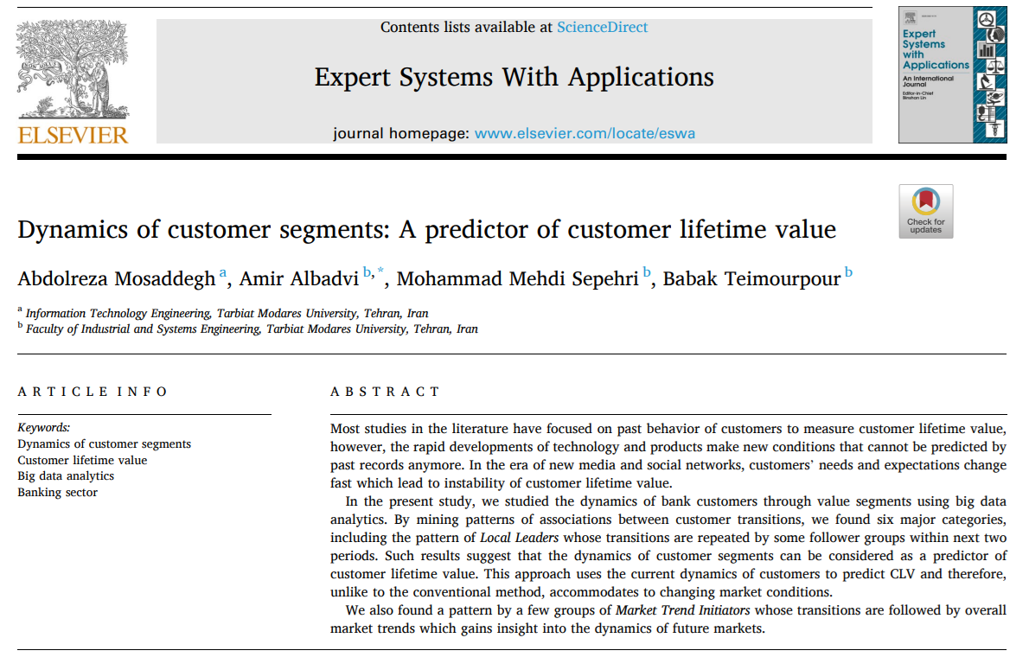
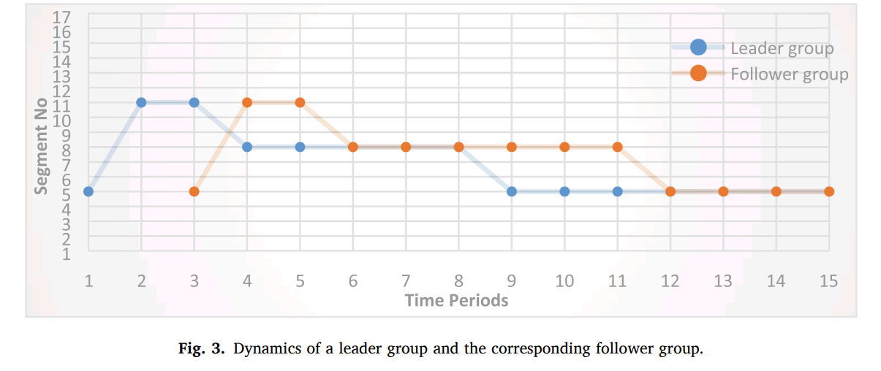
Ethical Issues in AI
A customer without any default, may be judged from his/her linkage to a defaulter leader group.

Slide 43
Why AI and Not Human ?
The problem size is too vast four human reasoning, calculating and memorizing capabilities, e.g., Translator of many Languages
The problem needs to be addressed with minimum latency, e.g., Financial Fraud Detection
The problem needs an accuracy rate which is not pragmatic for humans, e.g., Quality Control in Manufacturing
The problem needs a lot of human resources, and it is possible to reduce costs using AI, e.g., Customer Call Answering Service
The problem can be addressed by humans, but AI makes life easier !
e.g., Self-driving Car

Slide 44
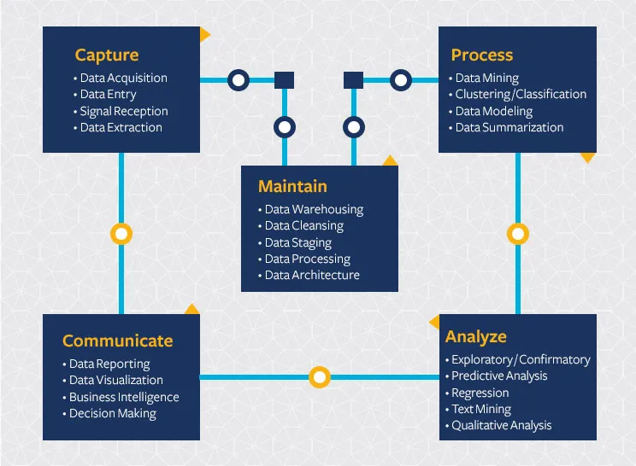
What is Data Science?
“The ability to take data — to be able to understand it, to process it, to extract value from it, to visualize it, to communicate it.”
Hal Varian
Berkeley

Slide 45
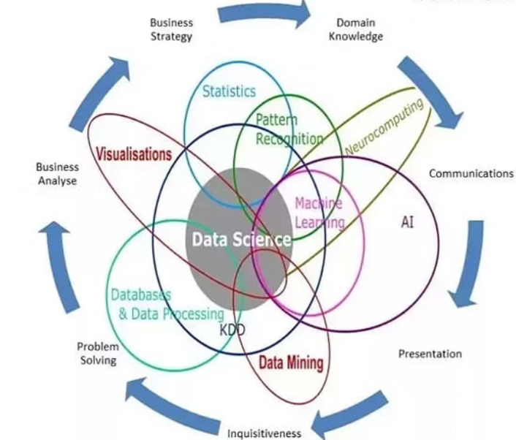
Data Science vs AI
Data science is a broad term not only focuses on algorithms and statistics but also takes care of the entire data processing methodology includes data cleansing, and visualization. Machine learning is used in data science to help processing and analyzing data.
Tierney

Slide 46
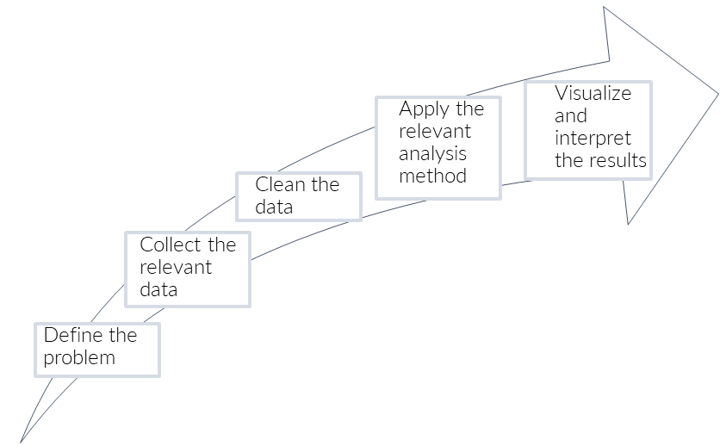
Data Analysis Steps

Slide 47
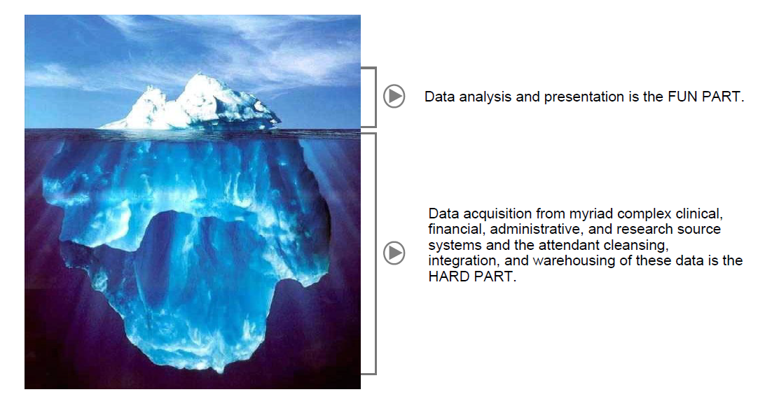
Oracle
“Cleaning and preparing the proper data for analysis can take up to 80% of a data scientist’s time.”
IBM

Slide 48
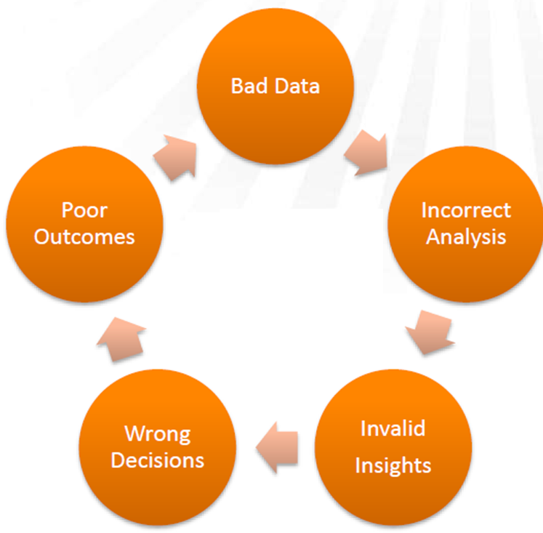
Why Data Preprocessing?
Usually, data in the real world is not clean
incomplete: lacking attribute values, lacking certain attributes of interest, or containing only aggregate data
e.g., occupation=“ ”
noisy: containing errors or outliers
e.g., Salary=“-10”
inconsistent: containing discrepancies in codes or names
e.g., Age=“42” Birthday=“03/07/1997”
e.g., Was rating “1,2,3”, now rating “A, B, C”
e.g., discrepancy between duplicate records
Garbage in, garbage out
Data preprocessing aka:
Data Wrangling
Data Preparation
Data Cleansing
Etc.
Old Dominion

Slide 49
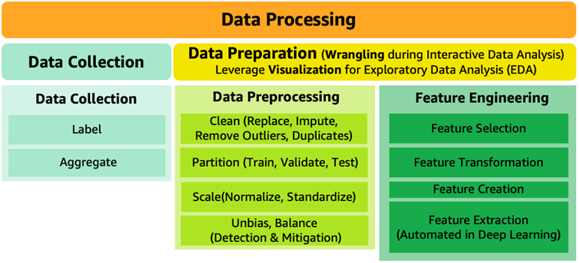
Major Tasks in Data Preprocessing
Data cleaning
Fill in missing values, smooth noisy data, identify or remove outliers, remove duplicates, resolve inconsistencies and discrepancies
Data integration
Data warehousing
Summarizing data
Data reduction
Dimensionality reduction
Numerosity reduction
Data transformation
Normalization
Discretization
Data Balancing, Feature Engineering, Data partitioning, etc.

Slide 50
Incomplete (Missing) Data
Data is not always available
E.g., have no recorded value for some attributes, such as customer income in sales data
Missing data may be due to
equipment malfunction
inconsistent with other recorded data and thus deleted
data not entered intentionally or due to misunderstanding
certain data may not be considered important at the time of design
not register history or changes of the data
Sometimes missing data may need to be inferred
Understanding the type of missing data is crucial because it determines the appropriate strategy for handling missing values

Slide 51
Types of Missing Data
Missing completely at random (MCAR): the missing data is independent of the observed and unobserved data (no systematic differences exist between participants with missing data and those with complete data) → imputable
e.g., some data items are missed due to hardware failure
Missing at random (MAR): the missing data is systematically related to the observed but not the unobserved data → imputable
e.g., male participants are less likely to answer a question on having depression
Missing not at random (MNAR): the missing data is systematically related to the unobserved data, that is, the missingness is related to events or factors which are not measured by the researcher → analysis is likely biased without these values
e.g., answers of criminals to the number of crimes they committed

Slide 52
Impute Missing Data
Ignore the tuple: not effective when many records have missing values or dataset is small
Fill in the missing value manually: not feasible when there are many missing values
Fill in it automatically with
a global constant value: e.g., 0, “unknown”, a new class
last reported value in historical data: assumes no change, which is usually wrong
the attribute mean
the attribute mean for all samples belonging to the same class / group
value of a record with similar other attributes (Hot Deck Imputation)
Imputation using prediction models: predict value of missing data using values of other attributes by a prediction model (e.g., regression)
Multiple Imputations (e.g., MICE)

Slide 53
Multiple Imputation with Chained Equations
MICE is a technique used to impute (fill in) multiple variables by modeling each variable with missing values as a function of the other variables in the dataset using a supervised algorithm (e.g., regression).
cran.r-project

Slide 54
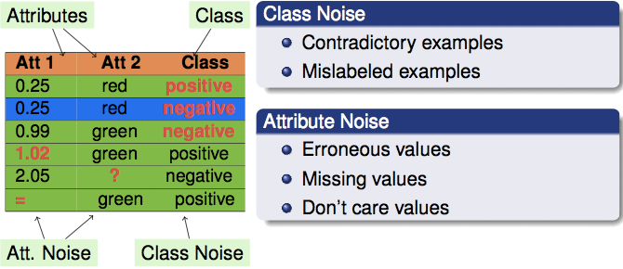
Noisy Data
Noise: random incorrect values in a measured variable
e.g., Negative Values in Age
Incorrect attribute values may be due to
faulty data collection instruments
data entry problems
data transmission problems
inconsistency in data
Notes:
54

Slide 55
How to Handle Noisy Data?
Binning
first sort data and partition into (equal-frequency) bins
then one can smooth by bin means, smooth by bin median, smooth by bin boundaries, etc.
Regression
smooth by fitting the data into regression functions
Clustering
detect and remove noises
Combined computer and human inspection
detect suspicious values using queries and check by human (e.g., deal with incorrect values)

Slide 56
Binning (Discretization)
Equal-width (distance) partitioning
Divides the range into N intervals of equal size: uniform grid
if A and B are the lowest and highest values of the attribute, the width of intervals will be: W = (B –A)/N.
The most straightforward, but outliers may dominate presentation
Equal-depth (frequency) partitioning
Divides the range into N intervals, each containing approximately same number of samples
Good data scaling

Slide 57
Binning Sample – Equal Depth
12 data points: 25, -5 , 29, 10, 33, 15, 21 , 28, 21, 25, 8, 26
1- Sorted data : -5, 8, 10, 15, 21, 21, 25, 25, 26, 28, 29, 33
2- Partition into 3 equal-depth bins:
- Bin 1: -5, 8, 10, 15
- Bin 2: 21, 21, 25, 25
- Bin 3: 26, 28, 29, 33
3- Smoothing by bin means:
- Bin 1: 7, 7, 7, 7
- Bin 2: 23, 23, 23, 23
- Bin 3: 29, 29, 29, 29

Slide 58
Outliers
Outliers are data points that deviate significantly from the rest of the data
Outliers can influence results of analysis
r = -.426
r = -.567
Same data, changed one value from 37 to 150

Slide 59
Identifying Outliers
Values that are greater than +3 standard deviations from the mean, or less than -3 standard deviations can be considered as outliers
SD of [34,35,41,56,71,75] = 16.53
M = 52.0
M + 3 SD’s = 101.06
SD of [34,35,41,56,71,150] = 40.37
M = 64.5
M + 3 SD’s = 185.61
sometimes SD is influenced by extreme values. So, having extreme values makes it harder to detect extreme values

Slide 60

Boxplots
IQR (interquartile ) method
set up a “fence” outside of Q1 and Q3. Any values that fall outside of this fence are considered outliers.
To build this fence take 1.5 times the IQR and then subtract this value from Q1 and add this value to Q3
neptune
In Python : q3, q1 = numpy.percentile(data, [75 ,25])

Slide 61
18 Samples

Slide 62
Addressing Outliers
Outlier as a noncompliance (Invalid)
E.g., age of 200 --> Delete the outlier
Replace the outlier with a value (e.g., median)
Winsorizing
Outlier as a real extreme value
E.g., Elon Musk salary --> Deleting valid cases biases your sample
Outlier as output
E.g., detecting fraud --> Outliers are outputs of process

Slide 63

Normalizing Data
Data normalization is a technique to transform the values of a dataset into a uniform scale (e.g., 0-1).
Some machine learning algorithms and loss functions are sensitive to the scale of the features.
min-max normalization: preserve scale but does not handle outliers well. A value between 0 and 1
New value = (Original value - Min) / (Max - Min)
z-score normalization: better handling of outliers but not exact same scale
New value = (Original value - Mean) / Standard deviation
Normalizing can make the outliers less influential.
Normalization can result in a loss of information in some datasets

Slide 64


Processing of Categorical Data
In some statistical and machine learning models the inputs should be numeric values
Nominal categorical variables are labels that take only a finite number of values without orders (e.g., colors)
It is incorrect to replace labels with different numerical values in a statistical model
Hot-encoding (dummy variable encoding) can be used for converting labels to numerical values
Ordinal categorical variables are labels that take only a finite number of values with orders (e.g., grades)
Sometimes labels can be replaced with different numerical values in a statistical model
Hot-encoding usually can be used for converting categories to numerical values

Slide 65


Data Integration
Electronic Files
Different interfaces
Different data structures
Duplicate and inconsistent information
World
Wide
Web
Databases
IOT
Berkeley

Slide 66
Data-Warehousing
Users
A data warehouse is a centralized repository for storing integrated data from multiple disparate sources
Data
Warehouse
Collects and combines information
Provides uniform and integrated view of data
Integration System
Metadata
. . .
Extract/
Transform/
Load
Extract/
Transform/
Load
Extract/
Transform/
Load
. . .
Source
Source
Source

Slide 67

Summarizing and Aggregating data
Data Aggregation: the process of combining multiple data entities into a unified, coherent dataset.
This consolidation allows for a comprehensive view of the information
e.g., aggregate health-related data from hospitals, clinics, and public health agencies
Data Summarization: converting large amounts of data into an informative summary of data.
It provides a bird's eye view of the data, making it easier to identify trends and patterns.
E.g., average age of customer groups instead of age of each individual customer
For some machine learning algorithms, data aggregation
and summarization are useful for data preparation
Data Loss: Data summarizing can result in data loss,
such as when combining attributes or features from the data.
Aggregated
and
Summarized

Slide 68

Data Exploration
Data exploration is the first step in data processing involving the use of data visualization and statistics
Data exploration can be used to recognize data structure, correlations, distribution noises, outliers
Information that gives a quick and simple description of the data:
Maximum value
Minimum value
Range (max – min)
Mean
Median
Mode
Quantile
Standard deviation
Etc.

Slide 69

Data Exploration - Distribution
Histogram allows the inspection of the data for its underlying distribution

Slide 70

Data Exploration - Noises and Outliers
Scatter plot showing noises and outliers

Slide 71

Data Exploration - Correlations
Scatter plots showing the correlations between two features
(from –1 to 1)

Slide 72

Correlation only measures linear relationship

Slide 73
Some Open Access Datasets
https://www.data.gov/
US-centric agriculture, climate, education, energy, finance, health, manufacturing data, …
https://cloud.google.com/bigquery/public-data/
BigQuery (Google Cloud) public datasets (bikeshare, GitHub, Hacker News, Form 990 non-profits, NOAA, …)
https://www.kaggle.com/datasets
Microsoft-owned, various (Billboard Top 100 lyrics, credit card fraud, crime in Chicago, global terrorism, world happiness, …)
https://aws.amazon.com/public-datasets/
AWS-hosted, various (NASA, genome stuff, Google Books n-grams, Multimedia Commons, …)

Slide 74
Assignment 1
The dataset contains insurance charges based on demographic attributes of customers.
Develop a code using a common programing language (Python, R, Java, C#, C++, etc.) over the dataset to remove outliers from BMI column and impute all missing values in the dataset.
Submit the code and the cleaned dataset in Canvas.
File name of Code : HW1_Code.[file type] (e.g., HW1_Code.py )
File name of Result : HW1_CleanedDataset.csv
age | gender | bmi | children | smoker | charges
19 | 0 | 27.9 | 0 | 1 | 16884.92
18 | 1 | 33.77 | 1 | 0 | 1725.552
28 | 1 | 33 | 3 | 0 | 4449.462
33 | 1 | 22.705 | 0 | 0 | 21984.47
32 | 1 | 28.88 | 0 | 0 | 3866.855
31 | 0 | 25.74 | 0 | 0 | 3756.622
46 | 0 | 33.44 | 1 | 0 | 8240.59
37 | 0 | 27.74 | 3 | 0 | 7281.506
37 | 1 | 29.83 | 2 | 0 | 6406.411
60 | 0 | 25.84 | 0 | 0 | 28923.14
25 | 1 | 26.22 | 0 | 0

